Slide 1
Scams targeting seniors and tips on how to prevent Fraud
Chief Rotta
November 16th, 2023
Tuckahoe Police Department
65 Main Street
Tuckahoe , NY 10707
914-961-4800
policedesk@tuckahoe-ny.com
Notes:
This template can be used as a starter file for presenting training materials in a group setting.
Sections
Sections can help to organize your slides or facilitate collaboration between multiple authors. On the Home tab under Slides, click Section, and then click Add Section.
Notes
Use the Notes pane for delivery notes or to provide additional details for the audience. You can see these notes in Presenter View during your presentation.
Keep in mind the font size (important for accessibility, visibility, videotaping, and online production)
Coordinated colors
Pay particular attention to the graphs, charts, and text boxes.
Consider that attendees will print in black and white or grayscale. Run a test print to make sure your colors work when printed in pure black and white and grayscale.
Graphics, tables, and graphs
Keep it simple: If possible, use consistent, non-distracting styles and colors.
Label all graphs and tables.

Slide 2
Fraud Prevention for Seniors
Senior citizens are too often the target of consumer fraud scams. Scammers prey on older adults, who are viewed as vulnerable, trustworthy and lonely easy prey with cash readily available. It’s important to familiarize yourself and recognize a scam or fraudulent activity to protect against becoming a victim.
Happening everywhere…… Tuckahoe, Bronxville, Eastchester, Scarsdale, Larchmont, Mamaroneck
Tuckahoe Police Department investigates these crimes through our video cameras , license plate readers, community ring cameras and even team up with other Police Departments to find individuals and/or organizations committing these crimes.
Notes:
Summarize presentation content by restating the important points from the lessons.
What do you want the audience to remember when they leave your presentation?

Slide 3
Scams Targeting Seniors
Grandparent Scams
Medical Device Scams
Home Improvement Scams
Ghosting Scams
Jury Duty Scams
Funeral Notification Scams
Sweepstakes/Charity Scams
IRS Imposter Scams
Check Washing Scams
Government Impersonation Scams
Romance Scams
Tech Support Scams
Phishing Scams
Utility Service Scams
Health Care/Medical/Health Insurance Fraud
The Pigeon Drop
Notes:
Summarize presentation content by restating the important points from the lessons.
What do you want the audience to remember when they leave your presentation?

Slide 4
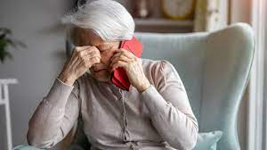
Grandparent Scam
These scammers call or email seniors impersonating to be a family member or a loved one—usually a grandchild—and state that they are in some kind of trouble, claims to be in a foreign country and have gotten in a bad situation, like being arrested for drugs, getting in a car accident or being mugged and needs money wired ASAP for a false expense such as bail money, lawyer’s fees, hospital bills and doesn’t want his or her parents told.
Often, the calls are made in the middle of the night, so the adult answering the phone may be disoriented.
These con artists seem credible because they have become sophisticated in finding and using personal information from social media and Internet searches.
Scammers are increasingly turning to artificial intelligence (AI) tools to clone the voices of individuals they target on social media to place panicked calls to their family or friends in the hope of convincing the unwitting recipient of the call to give them money or access to sensitive information
In some cases, the scammer impersonates a police officer, a lawyer, or a doctor who is calling on behalf of the relative in trouble.
In all cases, the scammers request that money be sent immediately and usually through a wire transfer.
Notes:
Give a brief overview of the presentation. Describe the major focus of the presentation and why it is important.
Introduce each of the major topics.
To provide a road map for the audience, you can repeat this Overview slide throughout the presentation, highlighting the particular topic you will discuss next.

Slide 5
Medical Device Scam
Seniors have reported receiving unsolicited prerecorded messages, known as “robocalls,” offering free medical alert devices, along with money saving coupons.
They identify the business as “Senior Medical Alert” or “Senior Medical Advisors.”
When answered, the message urges consumers to press 1 to receive a free device by providing an address and credit card information.
Pressing 1 puts the consumer through to a live operator, who uses scare tactics to elicit personal and financial information from the consumer.
The message also offers the option of pressing another number to opt out of future calls.
Pressing that number, however, alerts the scammers to a working phone number, which can be used for future scam calls.
The con artists will then ask the seniors for their credit card numbers and use it to bill them every month for “monitoring services” they never receive.
They also use scare tactics to induce consumers to respond to the offer, warning of a “significant rise” in the number of senior citizens who delayed, and as a result suffered death or serious life-threatening injuries.
Notes:
Give a brief overview of the presentation. Describe the major focus of the presentation and why it is important.
Introduce each of the major topics.
To provide a road map for the audience, you can repeat this Overview slide throughout the presentation, highlighting the particular topic you will discuss next.

Slide 6
Home Improvement Scams
Knocks on your door or calls you on the phone offering to make repairs.
Tells you that you must make repairs immediately.
Talks very quickly to confuse you and pressures you to sign a contract immediately.
Tells you they are doing work in your neighborhood and have extra materials left from another job.
Offers a discounted price if you refer other people to them, but only if you buy today.
Tells you something that sounds too good to be true. If it sounds too good to be true, it probably is!
Notes:
Give a brief overview of the presentation. Describe the major focus of the presentation and why it is important.
Introduce each of the major topics.
To provide a road map for the audience, you can repeat this Overview slide throughout the presentation, highlighting the particular topic you will discuss next.

Slide 7
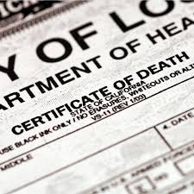
Ghosting Scams
“Ghosting” is a form of identity theft. Identity thieves obtain personal information about deceased persons from obituaries, funeral homes, hospitals, stolen death certificates, and online web sites.
Once they have the information, especially social security numbers, they use it to establish credit and open accounts, take out loans, receive benefits, or even collect tax refunds filed under the stolen identity.
Family members of the deceased are not responsible for charges resulting from this kind of identity theft as long as their names are not on the stolen accounts.
Remember, it’s important to inform the Social Security Administration of a death.

Slide 8
Jury Duty Scams
These scammers, pretending to be law enforcement officers or court officials, contact individuals to inform them that they have failed to report to jury duty.
As a consequence, victims are told to pay a fine by credit card to avoid arrest.
In many cases, when the victims inform the callers that they didn’t receive any jury duty information, callers emphasize citizen responsibility to appear for jury duty whether or not a notice has been received.
These scammers also coerce victims into providing personal information, such as social security numbers and date of birth, which can then be used for identity theft or other fraudulent activity.

Slide 9
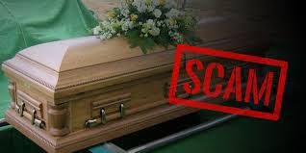
Funeral Notification Scams
The “funeral notifications” scam involves emails, which include the subject line "funeral notification," to deceptively inform recipients of an upcoming farewell ceremony in remembrance of a friend or loved one.
These emails appear to be sent from legitimate funeral homes and instruct recipients to click on a link for “more detailed information.”
The link sends victims to a third party web site where malware, or “malicious software,” is downloaded. This software causes computer havoc and allows scammers to gain access to the user’s computer information, which can then be used in fraudulent activity.
If you receive such an email, delete it immediately.

Slide 10
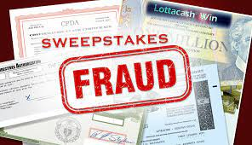
Sweepstakes/Charity Scams
Scammers claim to work for a charitable organization and many sweepstakes are run by con artists who are looking to access your personal information or tap into your accounts.
These scammers will say you won a sweepstake or various other prize offers , but will only collect once the fees and taxes are paid to them or ask you to share personal information to pay for the taxes or fees
Once the supposed fee is paid, they receive fake prize winning checks, which are deposited into consumer bank accounts.
Unfortunately, the checks are then rejected as counterfeit.
The con artists, meanwhile, have pocketed the money collected for fees or taxes on the prizes.
Remember, you never have to pay fees to participate in legitimate sweepstakes.

Slide 11
IRS Imposter Scams
Be alert to this “phishing” scam, one of the most sophisticated telephone scams to date.
In fact, according the Internal Revenue Service (IRS), at least 20,000 taxpayers have been targeted.
By impersonating IRS agents, these phone scammers demand immediate payment of overdue taxes from victims via debit card or wire transfer to avoid being arrested.
These scammers may even know the last four digits of a victim’s Social Security number.
In addition, victims report that scammers follow up with emails after a call.
If you receive an unexpected call from the IRS, it is most likely a scam.
Many times it’s difficult to determine if the call is a scam, but remember the IRS generally sends out prior notification of any action in the mail and never requires immediate payment over the phone, never asks for payment using a wire transfer or pre-paid debit card
Hang up and call IRS directly at : 1-800-829-1040.

Slide 12
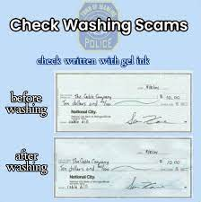
Check Washing Scams
Check washing scams involve changing the payee names and the dollar amounts on the checks and fraudulently depositing them
Checks are stolen from the mailboxes and washed in chemicals to remove the ink
Some scammers will even use copiers or scanners to print fake copies of a check

Slide 13
Government Impersonation Scams
Scammers claim to be a government employee and threaten to arrest or prosecute victims unless they agree to provide funds or other payments.
Scammer will call and identify themselves as a government agency, such as the Social Security Administration, Internal Revenue Service, U.S. Treasury, Border Security, FBI, etc., and claim that a warrant has been issued for your arrest. They will also state that a U.S. Marshal will appear at your door within the next 24 hours.
Scammer will then tell the victim to get gift cards from the store to provide them with payment and not to tell anybody about the call.

Slide 14
Romance Scams
Scammer takes advantage of people looking for romantic partners/companionship through dating websites or social media
You meet someone online, and after just a few contacts they profess strong feelings for you and ask to chat with you privately through telephone/email/text. After gaining your trust (can be weeks/months/year), they tell you a false story and ask for money, gifts, or your bank account/credit card details. They do not keep their promises and always have an excuse for why they cannot travel to meet you and why they always need more money.

Slide 15
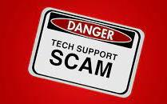
Tech Support Scams
Scammers act as a technology support representative and offer to fix non-existent computer issues. The scammer gains remote access to a victim’s computer or phone and their personal information.
A pop-up or blue screen appears on your computer, phone, or iPad/tablet with a warning sign that a virus has infected your device. The message urges you to call a toll free number or click a link immediately to get technical help. You will get a response from someone who claims to be working for a brand-name tech company, such as Apple/Google/Microsoft. They will ask you to pay for tech support through gift cards or wire transfers.

Slide 16
Phishing Scams
The use of emails and websites that falsely represent or claim to be associated with legitimate banks, financial intuitions or companies. The scammers manipulate internet users to disclose personal and financial data.
Scammers send out fake emails or set up fake websites in an effort to steal your personal information. Fraudsters always stay current with the news. Lately, many of these phishing attempts use keywords such as “coronavirus,” “COVID-19” and “stimulus.”

Slide 17
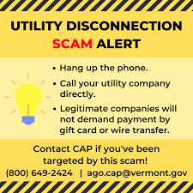
Utility Service Scams
Someone calls claiming to be from your gas, water, or electric company. They say your service will be cut off if you don't pay them immediately. This is a scam. Real utility companies don't do this. But these scammers want to scare you into paying, before you have time to confirm what they're telling you.
These scams tend to use aggressive and intimidating tactics. You’ll receive a call from a scammer claiming to be a representative of your local utility company or energy provider. They will insist you’re behind on your electricity bill payments and your account is delinquent. They often threaten to shut off your electricity or natural gas immediately, usually within the hour or that same day if you don’t pay up.
Be wary of callers who quickly try to get you to switch providers
If you miss the call, you may receive a message stating that you owe a large but specific amount of money, usually hundreds of dollars. The imposter will leave a callback number for their “direct line,” and a threat to disconnect your energy service that day.

Slide 18
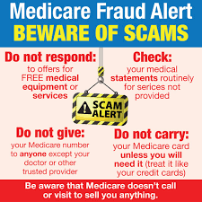
Health Care/Medicare/Health Insurance Fraud Scams
Every U.S. citizen or permanent resident over age 65 qualifies for Medicare, so there is rarely any need for anyone to research what private health insurance company older people have.
In these types of scams, perpetrators pose as Medicare representatives and trick seniors into providing personal information to them.
Scam artists use the personal information they collect to set up false identities (ID Theft) and to also bill Medicare for fake treatments and services that are never provided.

Slide 19
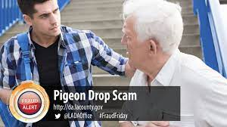
The Pigeon Drop Scams
The con artist tells the individual that he/she has found a large sum of money and is willing to split it, if the Senior will make a “good faith” payment to the con artist by withdrawing funds from his/her bank account.
Often, a second con artist is involved, posing as a lawyer, banker, or some other trustworthy stranger.

Slide 20
In addition to being familiar with common types of scams, recognizing warning signs can help prevent you from becoming the victim of a scam. Above all else, listen to your gut. If something feels off about a stranger’s request, it’s okay to be skeptical and investigate further before taking action
Notes:
What will the audience be able to do after this training is complete? Briefly describe each objective and how the audience will benefit from this presentation.

Slide 21
Red Flags that might indicate an interaction is fraudulent
Being pressured to send money
Threats of law enforcement action if you don’t comply (i.e. get arrested)
Asking for gift cards, cash, cryptocurrency, to wire cash or providing codes as a form of payment
Requests to deposit a check, but then send the money elsewhere

Slide 22
Tips to
Prevent a
Scam

Slide 23
Tips to Prevent a Scam
Don’t act quickly
Avoid odd payment types
Notice threatening behavior
Be suspicious of fake IDs
Be cautious of impersonation
Do not reveal personal or financial information
Avoid suspicious links
Ask a friend or family member
Add extra security to your accounts
Mail checks at the Post Office
Notes:
Summarize presentation content by restating the important points from the lessons.
What do you want the audience to remember when they leave your presentation?

Slide 24
Tips to Prevent a Scam
Don’t act quickly Scams are based on fear and urgency. Always take a little extra time to think it through and evaluate the legitimacy of what you are being asked to do.
Avoid odd payment types Scammers will often ask you to send them money with a wire transfer, money order, or gift card. Legitimate businesses will accept credit cards. Be suspicious of excuses for alternative forms of payment.
Notice threatening behavior Scams are often presented as urgent situations requiring immediate action. If you receive threats or hostility for asking questions that’s a sign they are a scammer.
Be suspicious of fake caller IDs Using computer software, scammers can make phone calls and emails that look like they're coming from legitimate companies, government organizations, or your local area code. It is often best to ignore contact from unknown numbers. At the very least avoid sharing private information. Looking up the organization's contact information and contacting them yourself is a safer option.
Be cautious of impersonation Con artists can sometimes pretend to be the government. Before making investments or online payments, be sure that you have confirmed that the organization is a legitimate business by asking for information about the company and checking that they are registered with the Better Business Bureau.
Do not reveal personal information Con artists can try to get you to provide them with personal information like your Social Security number, account numbers, passwords, credit cards, or other identifying information which can be sold to fraudsters.
Avoid suspicious links Don’t click on links in unsolicited emails, texts, or social media messages.
Ask a friend or family member Before giving out your credit card number or money, ask a friend or family member if the request or situation seems suspicious—particularly if you’ve been told by someone you don’t know that the person needs help.
Add extra security to your accounts Many online accounts let you turn on multifactor authentication. You may then need to enter a code that's sent to your phone or email, or that you generate with an app, before accessing your account. Enabling this extra security measure can keep scammers out of your accounts even if they get hold of your username and password.
The best way to protect yourself: hang up the phone, if you suspect you received a fraudulent call, call The
TUCKAHOE POLICE
(914)961-4800
Notes:
Summarize presentation content by restating the important points from the lessons.
What do you want the audience to remember when they leave your presentation?

Slide 25
Tips To Prevent Grandparent Scams
Contact your Grandchild or another family member to determine whether or not the call is legitimate
Never wire money based on a request made over the phone or in an e-mail, especially overseas

Slide 26
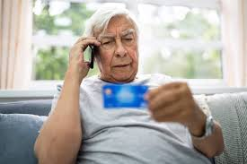
Tips to prevent Charity Scams
Contribute to known and verifiable charities
You can search the New York State Attorney General's online database of registered charities at https://ag.ny.gov/.
Beware of callers who want your money fast or use high-pressured tactics.
No legitimate organization will insist that you donate immediately.
Watch out for solicitors who employ dramatic, emotional or heart-tugging stories.
Avoid giving cash.
Don't send contributions with an "uber” driver, or overnight parcel pick-up
Be wary of unsolicited mailings, phone calls and e-mails requesting donations.
Don't click on any links in e-mails, as you may be directed to a fake website made to look like a legitimate organization's official site.
Don't disclose personal or financial information.
Never give your Social Security number, credit card or debit card number or other personal identifying information in response to an unsolicited charitable request, especially over the phone.

Slide 27
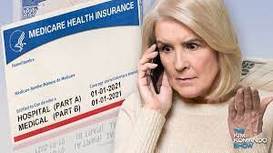
Tips to prevent Health Insurance Scams
Never sign blank insurance claim forms or authorizations for health services.
Carefully review your insurer's explanation of benefits statement to ensure it was you who actually received those services.
Only give your insurance/Medicare identification number to those who have provided you with medical services. Increasingly, more people are stealing a consumer's medical benefits information to obtain services in another person's name.

Slide 28
Don’t pick up the phone if you don’t recognize phone number or
Hang up the phone
Call Utility , Bank, IRS directly
Don’t respond to free medical equipment or services
Keep safe distance from strangers
Protect your personal information by storing in a safe and secure place. Do not keep important account numbers or data in purses , wallets or smartphones

Slide 29
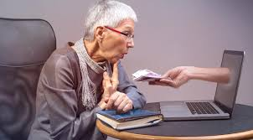
Do not click on any link or message that seems suspicious or unfamiliar.
Remember that most social networking sites will not ask for your password in an e-mail, message or a post.
Do not download any unknown files.
If you get a suspicious message, try to contact the friend who supposedly sent it to verify that the message is legitimate before following any links or instructions.

Slide 30
Anyone who believes they or someone they know to be a victim of a scam is urged to call
Tuckahoe Police at 914-961-4800
Complaints can also be filed directly with the Westchester County District Attorney’s Office at
(914) 995-TIPS (8477) or online through the Westchester County District Attorney Complaint Form.
Language assistance is available.

Slide 31
Questions?

